Slide 1

Project Plan
My Taxi Service Project

Slide 2
Purpose and Scope
To perform a preliminary analysis on the project feasibility
To indicate its required effort and time
To designate and allocate tasks
To perform risk assessment and recovery protocols

Slide 3
Effort Metrics
Two approaches
  Function Points: Preliminary size estimation
  COCOMO II: More refined, multipurpose effort metrics
No written code means these results are in no way verifiable on the field
Indeed, they foresee much less work than what we expected

Slide 4
Effort Metrics – Function Points
Many simple input functions: Login, Request taxi, Driver available…
Some complex output functions: Coverage checks, Request feasibility checks…
Low complexity ILFs for internal data storage
No ELFs: All data is handled by internal databases
A total of 125 Unadjusted Function Points
Or 5.750 estimated lines of code (JEE size factor = 46)

Slide 5
Effort Metrics – COCOMO II
Choice of values according to the COCOMO II Model Definition Manual
Parameter choice takes into account:
  Our inexperience with such a project → Low rating for most previous experience and familiarity parameters
  The favorable working conditions (working side by side, generous deadlines, etc) → High rating for most cohesion and teamwork parameters
  The lack of specific constraints on the software product → Nominal rating for most constraint parameters
Analysis result: 12 person-months, 2 people, 8 months
  A rather generous approximation for a project of this scope
  Parameters would probably be different if it were a real-world application

Slide 6
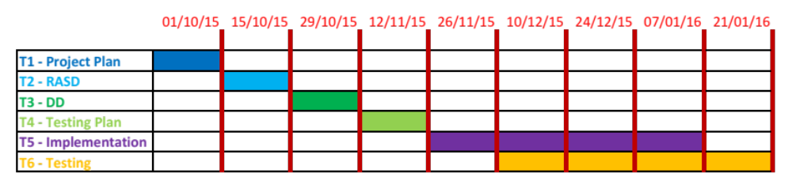
Project Tasks

Slide 7
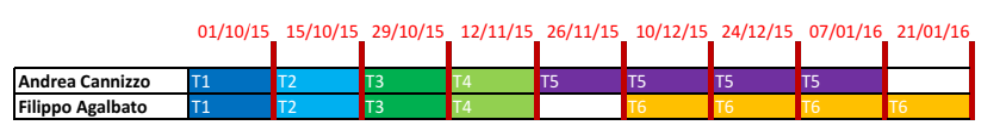
Resource Allocation

Slide 8
Risk Identifiction
R1 – Unrealistic schedule
R2 – Unavailability of staff caused by sudden problems (illness, other employments)
R3 – The discovery of a badly designed project
R4 – Inability to find skilled developers for the code writing
R5 – Wrong functionality
R6 – Inability to create some critical algorithms
R7 – New members in staff

Slide 9
Risk Evaluation
Risk | Probability | Effect
R1 | High | Marginal
R2 | Moderate | Serious
R3 | Moderate | Serious
R4 | High | Catastrophic
R5 | Low | Catastrophic
R6 | Low | Serious
R7 | Low | Marginal

Slide 10
Contingency Strategies Plan
R3 - The discovery of a badly designed project
Alert customers of delays
Push back release date
Change the design as little as possible to fix it while salvaging as much as possible from what has already been done
Investigate buying-in components to replace badly designed ones

